Slide 1
Attendance Management
Aditya R. Kajale
Guided By - Prof. G. P. Burkul

Slide 2

Content
Introduction to Requirement
Design
UML Diagrams
Demo

Slide 3
Requirement
Marking attendance on paper and then updating it in the computer is too lengthy.
The amount of work is double in manual update.
Sometimes by mistakenly the values might change while we update them manually.

Slide 4
Design
Add Class
Add Student
Class Record
Take Attendance
Attendance Record

Slide 5
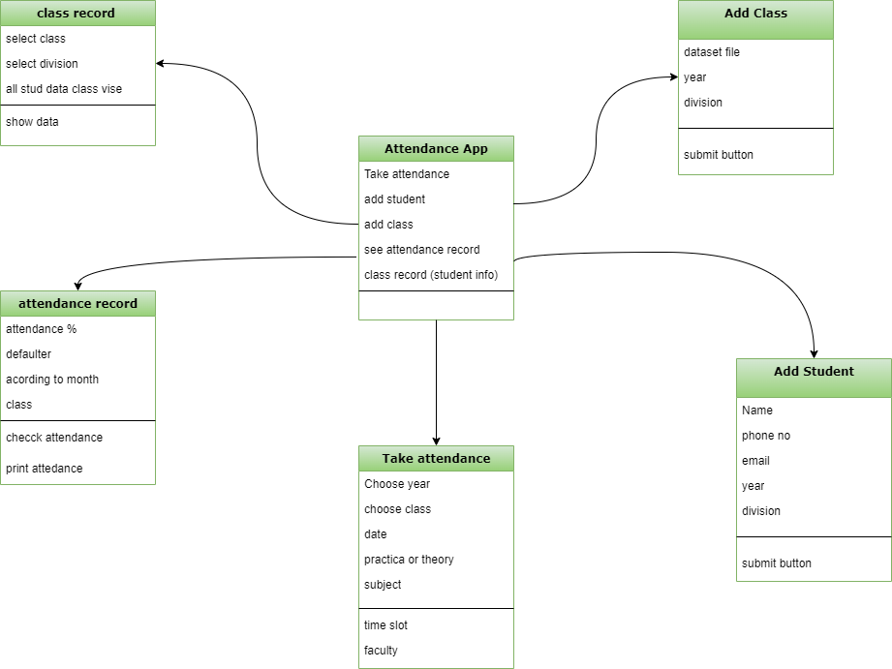
UML Diagrams

Slide 6
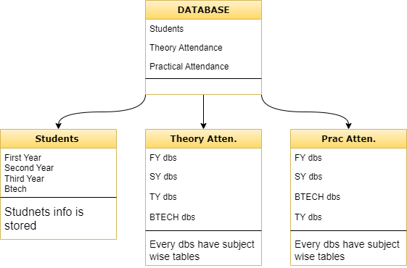

Slide 7
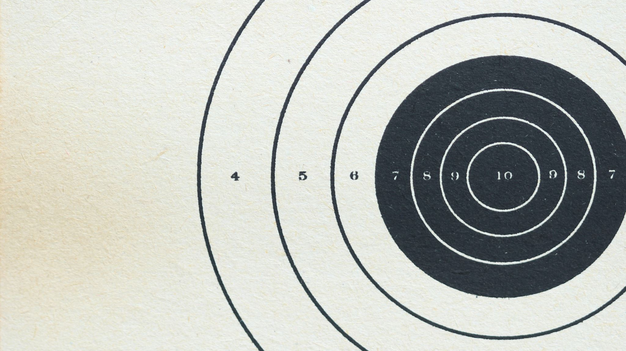
Demo

Slide 8

Thank You

